Slide 1

Monthly Business and Marketing Performance – January 2025 to December 2025
dd/dd/yyyy

Slide 2
PERFORMANCE OVERVIEW

Slide 3
Summary…
Add Insights…
Notes:
Excel Tab - Revenue Performance

Slide 4
Recommendations, Risks and Opportunities…
Recommendations | Risks | Opportunties
Notes:
Excel Tab - Revenue Performance

Slide 5
Revenue….
Date Range: January 2025 to December 2025
Revenue
Recent Month
£9.75m
Revenue from New Customers
Recent Month
67%
Revenue
Recent Month v Last Month
63%
Revenue
Recent Year Month v Last Year Month – Same Period
81%
Notes:
Data Source: Excel Tab - Revenue Performance

Slide 6
New Customers….
Date Range: January 2025 to December 2025
New Customers
Recent Month
6,600
Paid New Customers Recent Month
76%
New Customers
Recent Month v Last Month
21%
New Customers
Recent Year Month v Last Year Month – Same Period
67%
Notes:
Data Source: Excel Tab - Customers Performance

Slide 7
Paid Investment….
Date Range: January 2025 to December 2025
Paid Investment
Recent Month
£2.5m
Paid Investment v Total Investment in Recent Month
53%
Paid Investment
Recent Month v Last Month
14%
Paid Investment
Recent Year Month v Last Year Month – Same Period
43%
Notes:
Data Source: Excel Tab - Investment Performance

Slide 8
Investment Payback(LTV:CAC)….
Date Range: January 2025 to December 2025
Investment Efficiency
Recent Month LTV:CAC Ratio
2.43
Investment Efficiency
Target LTV:CAC
Ratio
3.10
Investment Efficiency
Recent Month v Last Month
15%
Investment Efficiency
Recent Year Month v Last Year Month – Same Period
23%
Notes:
Data Source: Excel Tab - LTV + CAC Performance

Slide 9
Customer Acquisition Cost (Fully Loaded CAC)….
Date Range: January 2025 to December 2025
Fully Loaded CAC
Recent Month
£720
Fully Loaded CAC
Average YTD
£890
Fully Loaded CAC
Recent Month v Last Month
-13%
Fully Loaded CAC
Recent Year Month v Last Year Month – Same Period
-19%
Notes:
Data Source: Excel Tab - CAC Performance

Slide 10
Blended CAC….
Date Range: January 2025 to December 2025
Blended CAC
Recent Month
£379
Blended CAC
Average YTD
£435
Blended CAC
Recent Month v Last Month
-6%
Blended CAC
Recent Year Month v Last Year Month – Same Period
-15%
Notes:
Data Source: Excel Tab - CAC Performance

Slide 11
Breakdown on Paid New Customers….
Date Range: January 2025 to December 2025
Paid New Customers
Recent Month
76%
Revenue Per New Paid Customer
Recent Month £1,950
Paid New Customers
Recent Month v Last Month
25%
Paid New Customers
Recent Year Month v Last Year Month – Same Period
67%
Notes:
Data Source: Excel Tab - Customers Performance
Additional Data from - Rev Per Customer Performance

Slide 12
Revenue Per Paid Customer….
Date Range: January 2025 to December 2025
Revenue Per New
Paid Customer
Recent Month
£1,950
Revenue Per Customer Recent Month
£704
Revenue Per New Paid Customer
Recent Month v Last Month
30%
Revenue Per New Paid Customer Recent Year Month v Last Year Month – Same Period
8%
Notes:
Data Source: Excel Tab - Rev Per Customer Performance

Slide 13
Customer Lifetime Value….
Date Range: January 2025 to December 2025
Customer Lifetime Value
Recent Month £2,300
Customer Lifetime Value
Target
£2K
Customer Lifetime Value
Recent Month v Last Month
10%
Customer Lifetime Value
Recent Year Month v Last Year Month – Same Period
40%
Notes:
Data Source: Excel Tab - LTV + CAC Performance

Slide 14
APPENDIX - SUPPORTING ANALYSIS

Slide 15
New v Repeat Customer Revenue….
Date Range: January 2025 to December 2025
Notes:
Data Source: Excel Tab - Revenue Performance

Slide 16
Paid v Organic New Customers….
Date Range: January 2025 to December 2025
Notes:
Data Source: Excel Tab - Customers Performance

Slide 17
New v Repeat Customers….
Date Range: January 2025 to December 2025
Notes:
Data Source: Excel Tab - Customers Performance

Slide 18
% Paid Ads Investment…
Date Range: January 2025 to December 2025
Notes:
Data Source: Excel Tab - Investment Performance

Slide 19
Paid v Organic v Repeat Revenue Per Customer…
Date Range: January 2025 to December 2025
Notes:
Data Source: Excel Tab - Rev Per Customer Performance

Slide 20
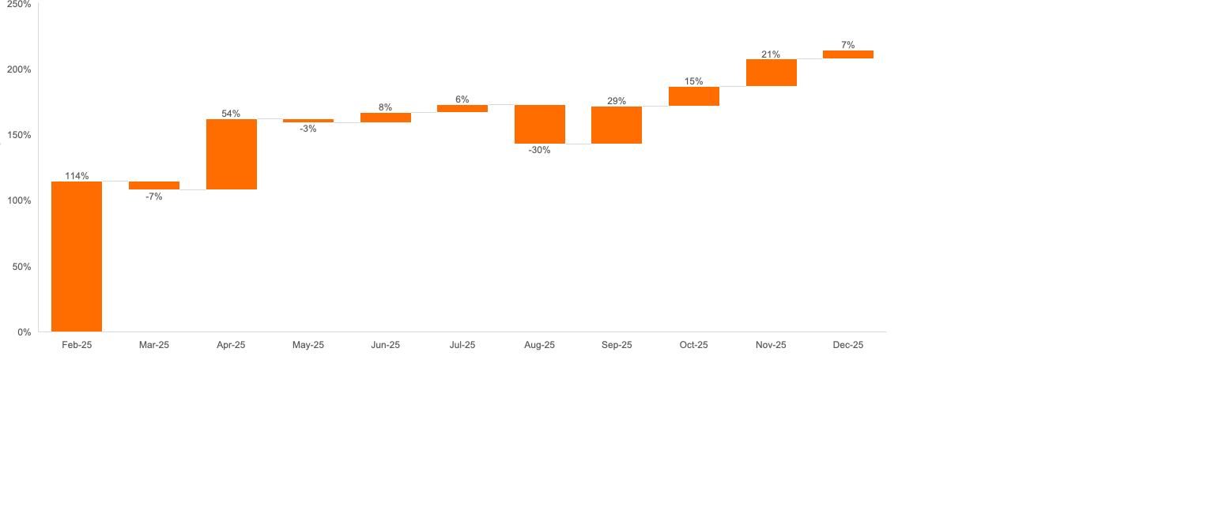
Total Revenue Changes...
Date Range: January 2025 to December 2025
Notes:
Data Source: Excel Tab - Revenue Performance

Slide 21
GLOSSARY & NOTES

Slide 22
Data Flow – How Excel and PowerPoint work together
Update Master All Data tab in Excel
Charts in PowerPoint should update auto but validate the changes can be seen
In Excel add additional data in all the tabs + update chart selection to add new data
In PowerPoint update summary + recommendations, risk and opportunities slides
Notes:
Excel Tab - Revenue Performance

Slide 23
Calculated Metrics…
Calculated Metric | Meaning | Formula
Total Revenue | New Customer Revenue + Repeat Customer Revenue | New Customer Revenue + Repeat Customer Revenue
New Customers | Organic New Customers + Paid New Customers | Organic New Customers + Paid New Customers
Repeat Customers | Customers who purchased multiple times | Total Customers - New Customers
Total Customers | New Customers + Repeat Customers | New Customers + Repeat Customers
% Paid New Customers | % of paid new customers among new customers | Paid New Customers / New Customers
% Organic New Customers | % of organic new customers among new customers | Organic New Customers / New Customers
% New Customers | % of new customers among total customers | New Customers / Total Customers
% Repeat Customers | % of repeat customers among total customers | Repeat Customers / Total Customers
Revenue Per Paid New Customer | Average revenue per paid new customer | New Customer Revenue / Paid New Customers
Revenue Per Organic New Customer | Average revenue per organic new customer | New Customer Revenue / Organic New Customers
Revenue Per Repeat Customer | Average revenue per repeat customer | Repeat Customer Revenue / Repeat Customers
Revenue Per Customer | Average revenue per customer | Total Revenue / Total Customers
% Paid Ads Investment | % of investment in paid marketing | Paid Ads Investment / Marketing Investment
% Organic Investment | % of investment in organic marketing | Organic Investment / Marketing Investment
LTV | Projected revenue from a customer over their lifetime | Business-specific calculation
Blended CAC | Cost to acquire a customer excluding overheads | Marketing spend / New Customers (simplified)
Fully Loaded CAC | CAC including all costs | Total acquisition cost / New Customers
Paid CAC | CAC for paid channels only | Paid Ads Investment / Paid New Customers
LTV:CAC | Ratio of LTV to CAC | LTV / CAC
Paid LTV:CAC | Ratio of LTV to Paid CAC | LTV / Paid CAC
Marketing ROI | Return on Investment | (Total Revenue - Marketing Investment) / Marketing Investment
MER | Marketing Efficiency Ratio | Total Revenue / Marketing Investment
Notes:
Excel Tab - Revenue Performance

Slide 24
Key Insight Box to add insights…
Key Insights
Key Insights
For each slide where additional insights are needed, copy one of these key insights box to the slide
Notes:
Excel Tab - Revenue Performance

